Slide 1


Final Project-Predictive Analytics
Predicting Trip Type Using Airfares Data
University of South Florida
Fall 2025- Dr. Ly Dinh
Andrew Burson, Sneh Patel, James Bressani, Matthew Humphreys

Slide 2





Overview
Goal: Predict if a flight is a vacation or business trip.
Data: Variables like fare, distance, income, population, and airline info.
Models: Logistic Regression, SVM, and Random Forest
Evaluation: 10–Fold Cross-Validation + Test Accuracy
Summary: Main takeaways from model results and final conclusions.

Slide 3

Variables & Outcome
Dataset: 638 flights, 18 variables
Outcome Variable:
Trip Type; whether the flight is Vacation (1) or Business (0)
Independent Variables:
Fare (price of the flight)
Distance (miles traveled)
City Income (income level of route cities)
Population (city population)
Airline (carrier information like SW.. ect)

Slide 4
Approach/Methods
1. Prepared the data
We checked the columns & cleaned dataset up. Set the trip type as the outcome.
2. Split the data
We used part of the data to train the models and saved the rest to test how well they worked.
3. Built three models
Logistic Regression
SVM
Random Forest
4. Evaluated each model
used 10-fold cross-validation
Then checked the accuracy on the test set
5. Picked the best model
Based on which one had the highest and most consistent accuracy

Slide 5
Model Results
Model Composition | Machine Learning Model | 10 Fold Cross Validation result | Prediction Accuracy on the Test Set
Model 1 (Base Model) | Logistic Regression | 80.8% | 72.2%
Model 2 (Improved Model) | Support Vector Machine | 91.6% | 85.5%
Model 3 (Improved Model) | Random Forest | 97.4% | 93.3%

Slide 6
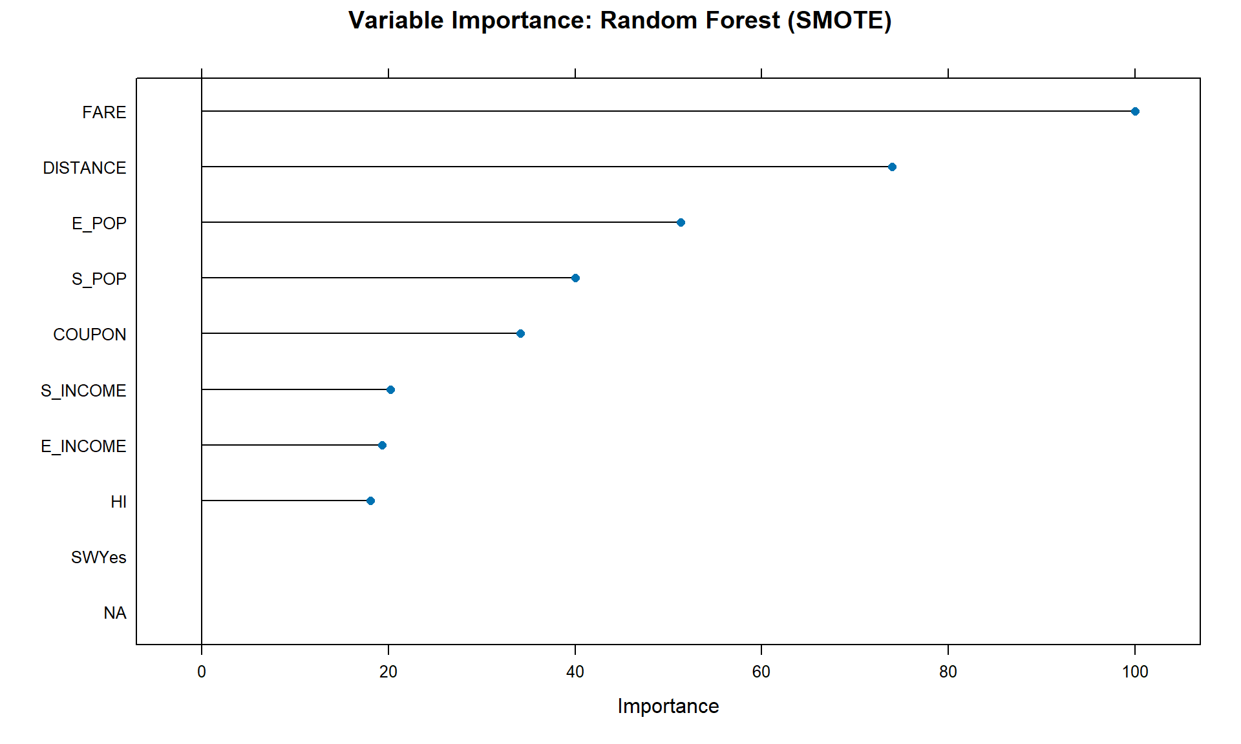
Key Predictors

Slide 7
Model Overview
Goal: classify trips as Business (0) or Vacation (1)
Built three predictive models
Logistics Regression → baseline approach
SVM → captures complex patterns
Random Forest → ensemble of decision trees
Compared performance using cross-validation + test accuracy

Slide 8
Model Logic
Logistic Regression: fits a linear boundary between classes
SVM: finds the “best separating margin” for trip types
Random Forest: multiple trees voting on the outcome
Handles nonlinear patterns + variable interactions
Result: RF produced the strongest and most stable predictions

Slide 9
Beyond the Bare Minimum

Slide 10

Beyond Minimum Requirements
Usage of 3 Modeling methods over the required 1
Evaluated both the cross validation+test accuracy
Added variable importance analysis

Slide 11
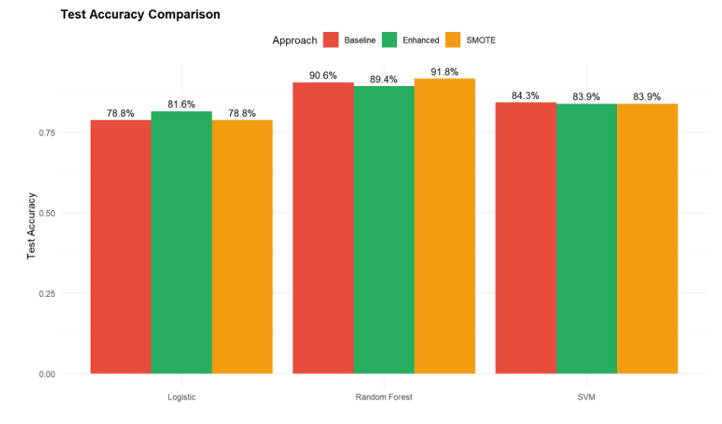
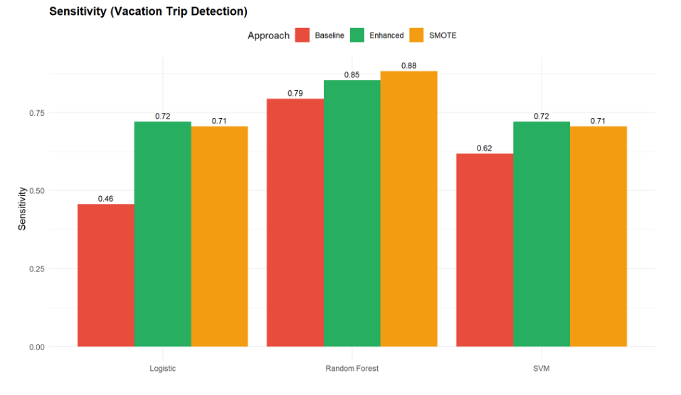
Advanced Techniques Used
Applied SMOTE to fix class imbalance
Improved sensitivity: 79.4% → 88.2%
Ensured models learned both classes fairly
10-fold CV ensured reliable performance
Strong generalization to new data

Slide 12
Recommendations and Conclusion
The Random Forest model with SMOTE achieved 91.8% accuracy, strong ROC (0.973), and balanced sensitivity (88.2%) and specificity (93.0%).
It proved robust and reliable through cross‑validation, outperforming alternatives while remaining interpretable and efficient.
Final recommendation: Deploy Random Forest with SMOTE for production use in the airline industry.

Slide 13

Insights
SMOTE effectively corrected class imbalance, boosting minority class detection and raising Random Forest sensitivity from 79.4% to 88.2%.
Random Forest with SMOTE clearly outperformed SVM and Logistic Regression, achieving 91.8% accuracy, a 7 to 13 point advantage.
Key predictors and rigorous validation ensured generalization, with CV ROC (0.969) closely matching Test ROC (0.973), confirming no overfitting.

Slide 14

Business Applications:
Airlines Can:
Optimize Pricing: Adjust fares based on trip purpose (business = premium, vacation = flexible)
Improve Route Planning: Allocate capacity and schedule flights based on predicted demand
Target Marketing: Personalized campaigns for vacation vs business travelers
Enhance Services: Customize amenities (Wi-Fi, meals, seating) by trip type

Slide 15

Final Summary Statistics
PROJECT AT A GLANCE
Data
638 flight routes analyzed
18 variables (demographics, pricing, route characteristics)
60/40 train-test split with stratification
Best Model
Algorithm: Random Forest
Enhancement: SMOTE resampling
Training: 10-fold cross-validation
Performance
Accuracy: 91.8%
ROC AUC: 0.973
Sensitivity: 88.2%
Specificity: 93.0%
GitHub: github.com/patelsnehr/LIS4805_Final_Project
Team: Andrew Burson, James Bressani, Matthew Humphreys, Sneh Patel

